Slide 1
Deep Learning based
Face Extraction and
Its Enhancement Pipeline

Slide 2
PROBLEM STATEMENT
The project aims to develop a pipeline for face detection, extraction, and enhancement using computer vision techniques.
Aims to develop a pipeline that can handle severely degraded or low-resolution videos, where the face bounding boxes may become too small or lack sufficient detail for effective enhancement.
Aims to improve the visual quality and resolution of the extracted face bounding boxes, especially when dealing with poor quality videos.

Slide 3
OBJECTIVE
The objective of the project is to develop a pipeline for face detection, extraction, and enhancement using computer vision techniques. The pipeline aims to improve the visual quality and resolution of the extracted face bounding boxes, especially when dealing with poor quality videos.
Specific Workflow
Object detection model for human keypoint detection
Extraction of face bounding boxes based on the detected facial keypoints
Saving those Face bounding boxes
Upsampling techniques using tensorflow
ESRGAN for face enhancement

Slide 4
Technology Stack
Computer Vision OpenCV
YOLO-v8 Pose Detection Model
Tensorflow platform for Upsampling , Conv2D layers
ESRGAN model Generative Adversarial Network

Slide 5
Assumptions
Single person CCTV feed [If multiple only high confidence is considered]
Sufficiently good quality footage for better enhancement

Slide 6
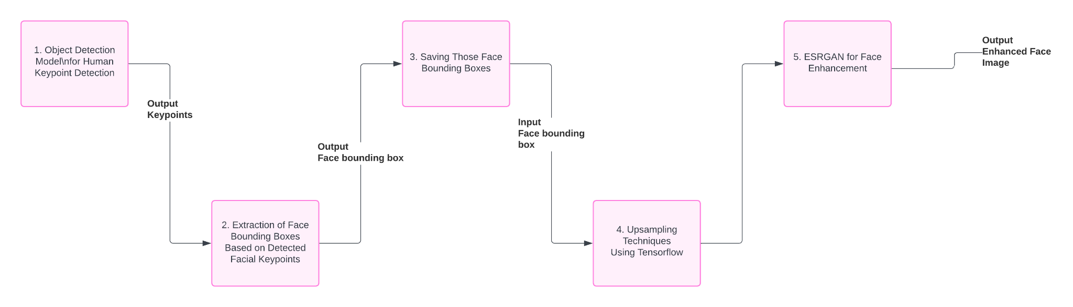
Approach

Slide 7
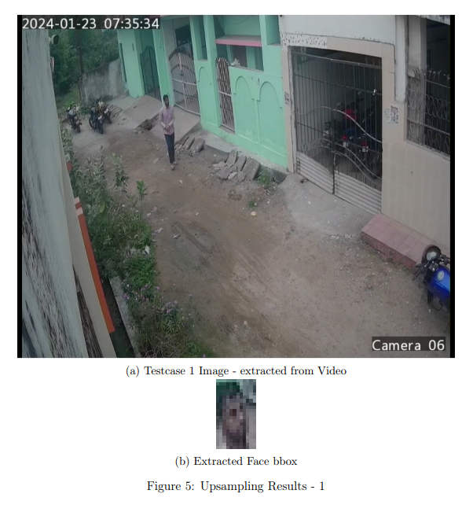
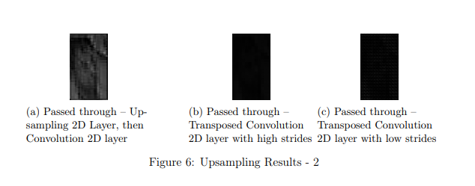
Results - Conventional Sampling

Slide 8
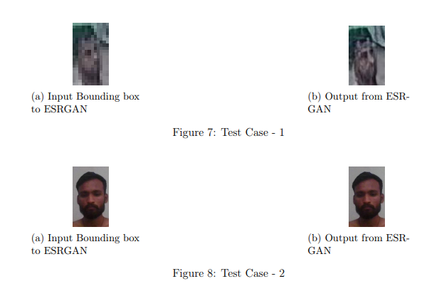
Results - ESRGAN enhancement

Slide 9
Conclusion
The project's pipeline for face detection, extraction, and enhancement using computer vision techniques has several advantages, including its ability to handle poor quality videos and the use of the YOLOv8 object detection model and the ESRGAN pre-trained model for enhanced performance. However, the pipeline has a limitation, as it may not perform optimally on extremely small or degraded face images.

